Slide 1
Java Collections

Slide 2
Collection
Collections are an interface in the java.util package, and as its name suggests, it is used to define a collection of objects.
There are many different classes which implement the collections interface.

Slide 3
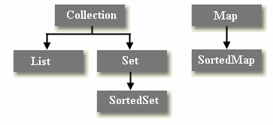
Collections Interfaces

Slide 4
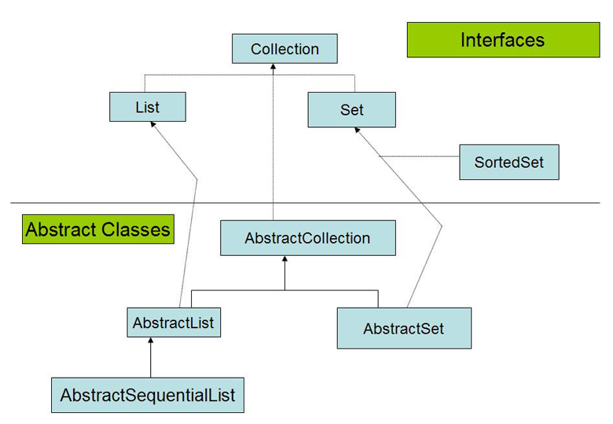
Collections Abstract Classes

Slide 5
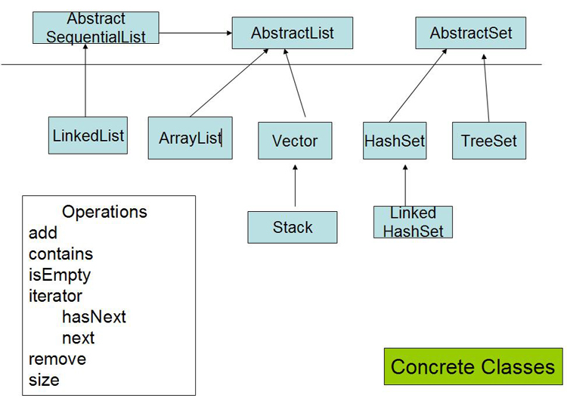
Collections Concrete Classes

Slide 6
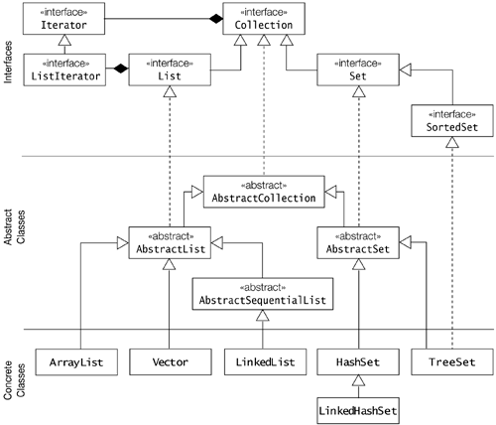

Slide 7
Collection interface methods
boolean add(Object obj)
Adds obj to the invoking collection. Returns true if obj was added to the collection. Returns false if obj is already a member of the collection, or if the collection does not allow duplicates.

Slide 8
Collection interface methods cont....
void clear( )
Removes all elements from the invoking collection.
boolean contains(Object obj)
Returns true if obj is an element of the invoking collection. Otherwise, returns false.

Slide 9
boolean equals(Object obj)
Returns true if the invoking collection and obj are equal. Otherwise, returns false.
int hashCode( )
Returns the hash code for the invoking collection.
boolean isEmpty( )
Returns true if the invoking collection is empty. Otherwise, returns false.

Slide 10
boolean remove(Object obj)
Removes one instance of obj from the invoking collection. Returns true if the element was removed. Otherwise, returns false.
int size( )
Returns the number of elements held in the invoking collection.

Slide 11
List Interface
The List interface extends Collection and declares the behavior of a collection that stores a sequence of elements.
Elements can be inserted or accessed by their position in the list, using a zero-based index.
A list may contain duplicate elements.
In addition to the methods defined by Collection, List defines some of its own, which are summarized in the following

Slide 12
List Interface Methods
void add(int index, Object obj)
Inserts obj into the invoking list at the index passed in index. Any preexisting elements at or beyond the point of insertion are shifted up. Thus, no elements are overwritten.
Object get(int index)
Returns the object stored at the specified index within the invoking collection.

Slide 13
int indexOf(Object obj)
Returns the index of the first instance of obj in the invoking list. If obj is not an element of the list, -1 is returned.
int lastIndexOf(Object obj)
Returns the index of the last instance of obj in the invoking list. If obj is not an element of the list, -1 is returned.

Slide 14
Object remove(int index)
Removes the element at position index from the invoking list and returns the deleted element. The resulting list is compacted. That is, the indexes of subsequent elements are decremented by one
Object set(int index, Object obj)
Assigns obj to the location specified by index within the invoking list.

Slide 15
Set Interface
A Set is a Collection that cannot contain duplicate elements.
The Set interface contains only methods inherited from Collection and adds the restriction that duplicate elements are prohibited.

Slide 16
SortedSet Interface
The SortedSet interface extends Set and declares the behavior of a set sorted in ascending order.
In addition to those methods defined by Set, the SortedSet interface declares the methods summarized in below

Slide 17
SortedSet Methods
Object first( )
Returns the first element in the invoking sorted set.
Object last( )
Returns the last element in the invoking sorted set.
SortedSet subSet(Object start, Object end)
Returns a SortedSet that includes those elements between start and end-1. Elements in the returned collection are also referenced by the invoking object.

Slide 18
SortedSet headSet(Object end)
Returns a SortedSet containing those elements less than end that are contained in the invoking sorted set.
SortedSet tailSet(Object start)
Returns a SortedSet that contains those elements greater than or equal to start that are contained in the sorted set.

Slide 19
Enumeration & Iterator
Enumeration
----------------
hasMoreElements()
nextElement()
Iterator
--------------
hasNext()
next()
remove()

Slide 20
LinkedList
The LinkedList class extends AbstractSequentialList and implements the List interface.
Apart from the methods inherited from its parent classes, LinkedList defines following methods

Slide 21
LinkedList Methods
void addFirst(Object o)
Inserts the given element at the beginning of this list.
void addLast(Object o)
Appends the given element to the end of this list.
Object getFirst()
Returns the first element in this list.

Slide 22
Object getLast()
Returns the last element in this list
Object removeFirst()
Removes and returns the first element from this list.
Object removeLast()
Removes and returns the last element from this list.

Slide 23
LinkedList Example
import java.util.*;
class LinkedListDemo {
public static void main(String args[]) {
LinkedList ll = new LinkedList();
ll.add("F");
ll.add("B");
ll.add("D");
ll.add("E");
ll.add("C");
ll.addLast("Z");
ll.addFirst("A");
ll.add(1, "A2");
System.out.println("Original contents of ll:"+ll);
ll.remove("F");
ll.remove(2);
System.out.println("Contents of ll after deletion:"+ll);
ll.removeFirst();
ll.removeLast();
System.out.println("ll after deleting first and last:"+ll);
}}
Original contents of ll:[A, A2, F, B, D, E, C, Z]
Contents of ll after deletion:[A, A2, D, E, C, Z]
ll after deleting first and last:[A2, D, E, C]

Slide 24
ArrayList
The ArrayList class extends AbstractList and implements the List interface. ArrayList supports dynamic arrays that can grow as needed.
Standard Java arrays are of a fixed length. After arrays are created, they cannot grow or shrink, which means that you must know in advance how many elements an array will hold.

Slide 25
ArrayList
import java.util.*;
class ArrayListDemo {
public static void main(String args[]) {
ArrayList al = new ArrayList();
System.out.println("Initial size of al:"+al.size());
al.add("C");
al.add("A");
al.add("E");
al.add("B");
al.add("D");
al.add("F");
al.add(1, "A2");
System.out.println("Size of al after additions:"+al.size());
System.out.println("Contents of al: " + al);
al.remove("F");
al.remove(2);
System.out.println("Size of al after deletions:"+al.size());
System.out.println("Contents of al: " + al);
} }
Initial size of al:0
Size of al after additions:7
Contents of al: [C, A2, A, E, B, D, F]
Size of al after deletions:5
Contents of al: [C, A2, E, B, D]

Slide 26
Vector
Vector implements a dynamic array. It is similar to ArrayList, but with two differences:
Vector is synchronized.
Vector contains many legacy methods that are not part of the collections framework.

Slide 27
Vector Methods
void addElement(Object obj)
Adds the specified component to the end of this vector, increasing its size by one.
Object firstElement()
Returns the first component (the item at index 0) of this vector.
Object lastElement()
Returns the last component of the vector.
void setSize(int newSize)
Sets the size of this vector.

Slide 28
Example
import java.util.*;
class VectorDemo {
public static void main(String args[]) {
Vector v = new Vector(3, 2);
System.out.println("Initial size: " + v.size());
System.out.println("Initial capacity:"+v.capacity());
v.addElement(new Integer(1));
v.addElement(new Integer(2));
v.addElement(new Integer(3));
v.addElement(new Integer(4));
System.out.println("Capacity after four additions:"+v.capacity());
v.addElement(new Double(5.45));
System.out.println("Current capacity:"+v.capacity());
v.addElement(new Double(6.08));
v.addElement(new Integer(7));
System.out.println("Current capacity:"+v.capacity());
System.out.println("First element:"+v.firstElement());
System.out.println("Last element:"+v.lastElement());
if(v.contains(new Integer(3)))
System.out.println("Vector contains 3.");
Enumeration vEnum = v.elements();
System.out.println("\nElements in vector:");
while(vEnum.hasMoreElements())
System.out.print(vEnum.nextElement() + " ");
System.out.println(); } }
Initial size: 0
Initial capacity:3
Capacity after four additions:5
Current capacity:5
Current capacity:7
First element:1
Last element:7
Vector contains 3.
Elements in vector:
1 2 3 4 5.45 6.08 7

Slide 29
Stack
Stack is a subclass of Vector that implements a standard last-in, first-out stack.
Stack includes all the methods defined by Vector, and adds several of its own.

Slide 30
Stack Methods
Object peek( )
Returns the element on the top of the stack, but does not remove it.
Object pop( )
Returns the element on the top of the stack, removing it in the process.
Object push(Object element)
Pushes element onto the stack. element is also returned.
int search(Object element)
Searches for element in the stack. If found, its offset from the top of the stack is returned. Otherwise, .1 is returned.

Slide 31
Stack Example
import java.util.*;
class stackDemo {
public static void main(String args[]) {
Stack s=new Stack();
s.push(new Integer(10));
s.push(new Integer(20));
s.push(new Integer(30));
System.out.println("Elements:"+s);
System.out.println(s.peek());
System.out.println("Elements:"+s);
s.pop();
System.out.println("Elements:"+s);
} }
Elements:[10, 20, 30]
30
Elements:[10, 20, 30]
Elements:[10, 20]

Slide 32
HashSet
HashSet extends AbstractSet and implements the Set interface.

Slide 33
HashSet Example
import java.util.*;
class HashSetDemo {
public static void main(String args[]) {
HashSet hs = new HashSet();
hs.add("B");
hs.add("A");
hs.add("D");
hs.add("E");
hs.add("C");
hs.add("F");
System.out.println(hs);
} }
[D, E, F, A, B, C]

Slide 34
HashSet Example
import java.util.*;
class HashSetDemo {
public static void main(String args[]) {
HashSet hs = new HashSet();
hs.add("B");
hs.add("A");
hs.add("D");
hs.add("E");
hs.add("C");
hs.add("F");
hs.add("A");//duplicate value
System.out.println(hs);
} }
[D, E, F, A, B, C]

Slide 35
LinkedHashSet
import java.util.*;
class HashSetDemo {
public static void main(String args[]) {
LinkedHashSet hs = new LinkedHashSet();
hs.add("B");
hs.add("A");
hs.add("D");
hs.add("E");
hs.add("C");
hs.add("F");
System.out.println(hs); } }
[B, A, D, E, C, F]

Slide 36
TreeSet
TreeSet provides an implementation of the Set interface that uses a tree for storage.
Objects are stored in sorted, ascending order.

Slide 37
TreeSet Example
import java.util.*;
class HashSetDemo {
public static void main(String args[]) {
TreeSet hs = new TreeSet();
hs.add("B");
hs.add("A");
hs.add("D");
hs.add("E");
hs.add("C");
hs.add("F");
System.out.println(hs);
} }
[A, B, C, D, E, F]

Slide 38
Map Interface
The Map interface maps unique keys to values. A key is an object that you use to retrieve a value at a later date.
Given a key and a value, you can store the value in a Map object. After the value is stored, you can retrieve it by using its key.

Slide 39
Map Interface Methods
void clear( )
Removes all key/value pairs from the invoking map.
boolean containsKey(Object k)
Returns true if the invoking map contains k as a key. Otherwise, returns false.
boolean containsValue(Object v)
Returns true if the map contains v as a value. Otherwise, returns false.

Slide 40
Object get(Object k)
Returns the value associated with the key k.
boolean isEmpty( )
Returns true if the invoking map is empty. Otherwise, returns false.
Object put(Object k, Object v)
Puts an entry in the invoking map, overwriting any previous value associated with the key. The key and value are k and v, respectively. Returns null if the key did not already exist. Otherwise, the previous value linked to the key is returned.

Slide 41
Object remove(Object k)
Removes the entry whose key equals k.
int size( )
Returns the number of key/value pairs in the map.

Slide 42
SortedMap
The SortedMap interface extends Map.
It ensures that the entries are maintained in ascending key order

Slide 43
SortedMap Methods
Object firstKey( )
Returns the first key in the invoking map.
SortedMap headMap(Object end)
Returns a sorted map for those map entries with keys that are less than end.
Object lastKey( )
Returns the last key in the invoking map.
SortedMap subMap(Object start, Object end)
Returns a map containing those entries with keys that are greater than or equal to start and less than end
SortedMap tailMap(Object start)
Returns a map containing those entries with keys that are greater than or equal to start.

Slide 44
HashMap Example
import java.util.*;
class hashmapdemo{
public static void main(String args[]){
HashMap h=new HashMap();
h.put(1,new String("one"));
h.put(5,new String("five"));
h.put(2,new String("two"));
System.out.println("Elements:"+h);
System.out.println(h.get(5));
h.remove(5);
System.out.println("Elements:"+h);
} }
Elements:{1=one, 2=two, 5=five}
five
Elements:{1=one, 2=two}

Slide 45
HashMap Example
import java.util.*;
class hashmapdemo{
public static void main(String args[]){
HashMap h=new HashMap();
h.put(1,new String("one"));
h.put(new String("hello"),new String("five"));
h.put(2,new String("two"));
h.put(new Character('a'),new String("kkkk"));
h.put(new Character('A'),new String("lll"));
h.put(new Character('b'), new String("jjjj"));
System.out.println("Elements:"+h);
} }
Elements:{hello=five, 1=one, 2=two, b=jjjj, A=lll, a=kkkk}

Slide 46
TreeMap Example
import java.util.*;
class hashmapdemo{
public static void main(String args[]){
TreeMap t=new TreeMap();
t.put(1,new String("one"));
t.put(5,new String("five"));
t.put(2,new String("two"));
System.out.println("Elements:"+t);
} }
Elements:{1=one, 2=two, 5=five}

Slide 47
TreeMap Example
import java.util.*;
class hashmapdemo{
public static void main(String args[]){
TreeMap t=new TreeMap();
t.put(new Character('B'),new Integer(10));
t.put(new Character('C'),new Integer(20));
t.put(new Character('A'),new Integer(30));
System.out.println("Elements:"+t);
} }
Elements:{A=30, B=10, C=20}

